Slide 1
Client needs and satisfaction
Tribunal Excellence Framework
October 2017

Slide 2
Service snapshot

Slide 3
Why tribunals exist
“It should never be forgotten that tribunals exist for users, and not the other way round.
No matter how good tribunals may be, they do not fulfil their function unless they are accessible by the people who want to use them ...”
Sir Andrew Leggatt 2001 International Framework for Tribunal Excellence

Slide 4
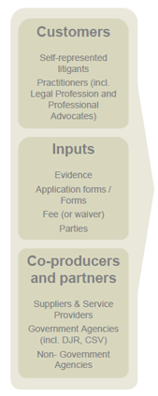
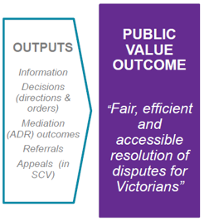
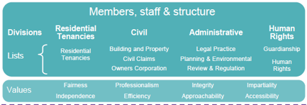
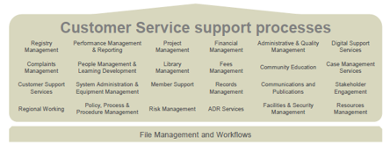
Our public value statement

Slide 5
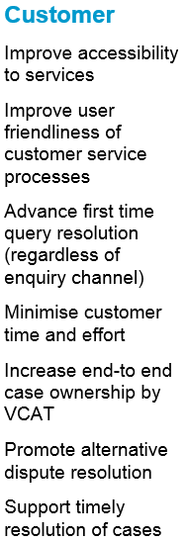
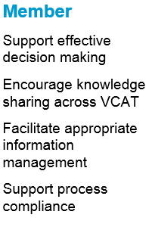
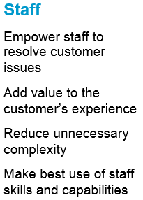
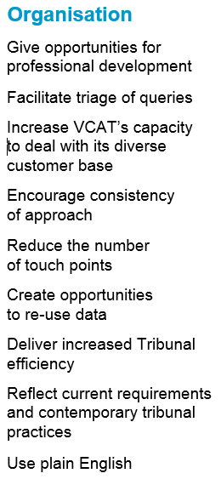
Key design principles

Slide 6
Key service enhancements
Customer Service Improvement Program
Streamline processes in registry
Single phone number, call reason codes, professional contact centre
Annual customer satisfaction surveys and public reporting
Digital strategy
Electronic lodgement, electronic files, Online Dispute Resolution pilot
User-centric website
vcat.vic.gov.au
Inclusion
Accessibility Action Plan - aligns with State Disability Action Plan
Koori Inclusion Action Plan – new Koori Engagement Officer
Expand access to alternative dispute resolution

